Slide 1
INCLUSIVE INSURANCE INNOVATION LAB
PECHA KUCHA
(run in full screen for narration)
Notes:
Ladies and gentlemen! Let me take you back to the 15th century… the beginning of the Age of Exploration. This is the beginning of globalisation. Our chart here from 1502 shows the explorations of Columbus to Central America, Corte-Real to Newfoundland, Vasco De Gama to India and Cabral to Brazil.

Slide 2
Image credit: anonymous Portuguese (1502) - Biblioteca Estense Universitaria, Modena, Italy

Slide 3
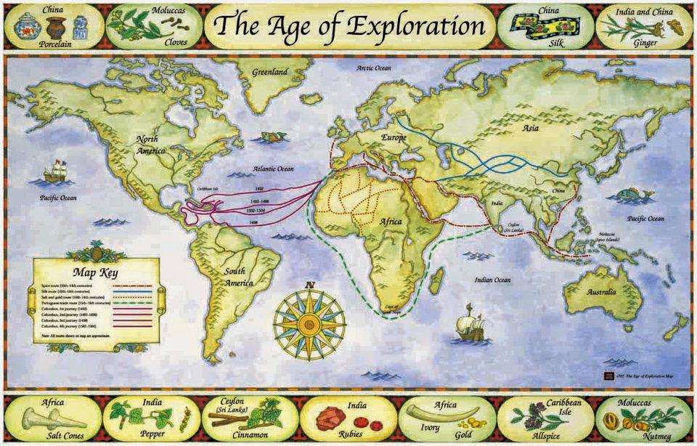

Slide 4
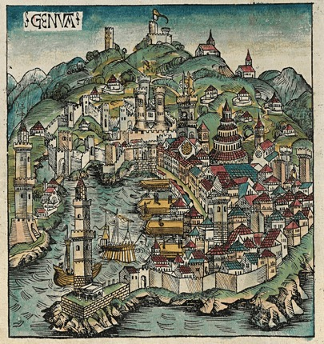
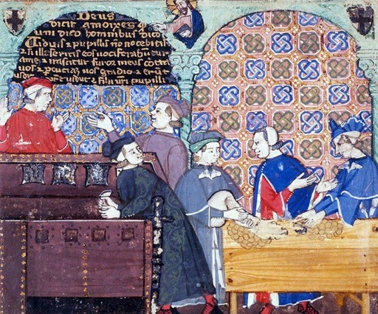
Image credits: Top left, Woodcut from the Nuremberg Chronicle, 1493, Top right, 15th Century manuscript, Bottom, Pixabay

Slide 5
Image from Pixabay

Slide 6
Images from Pixabay

Slide 7
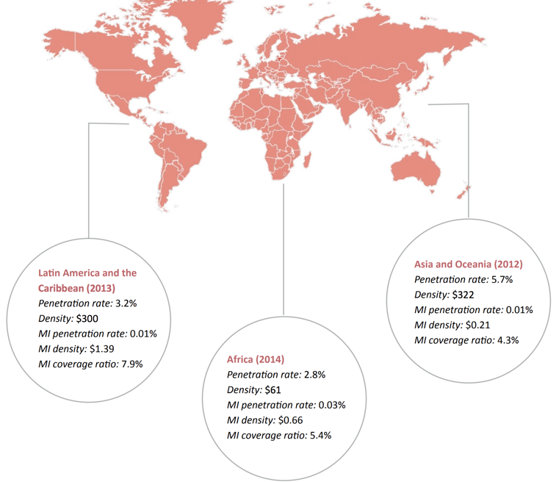
Image: A2ii

Slide 8
The Inclusive Insurance Innovation Lab
Image from Pixabay

Slide 10
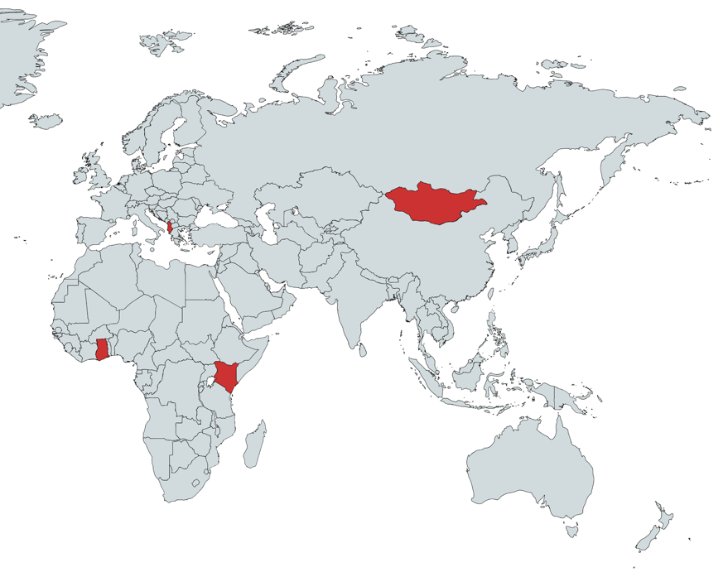
Albania
Mongolia
Ghana
Kenya

Slide 11
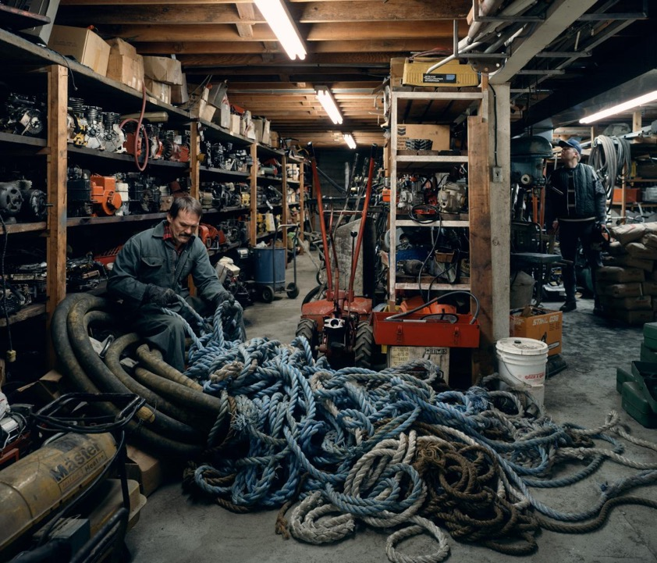
Image Credit: Jeff Wall, Untangling, 1994

Slide 12
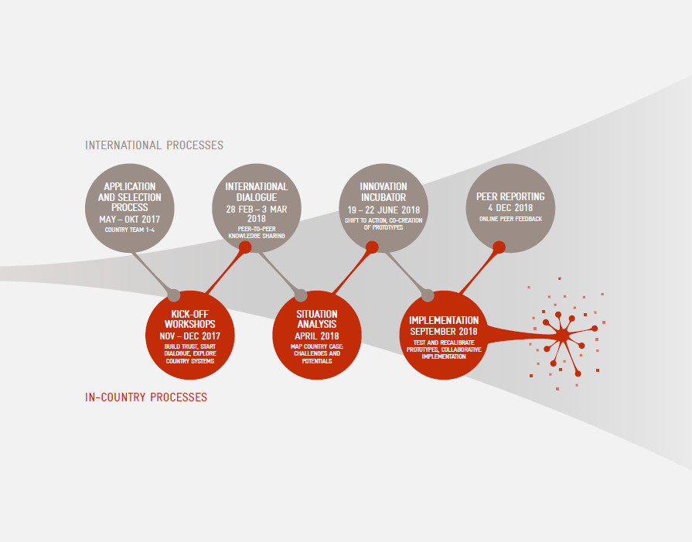

Slide 13
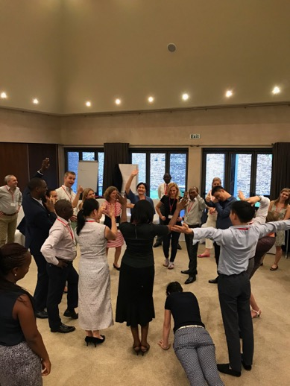
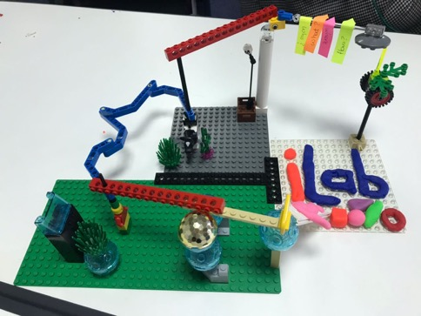

Slide 14
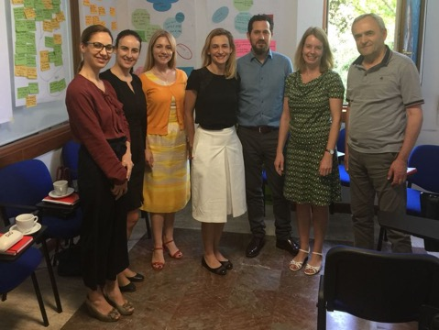
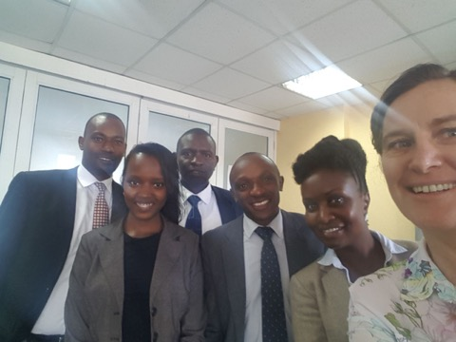
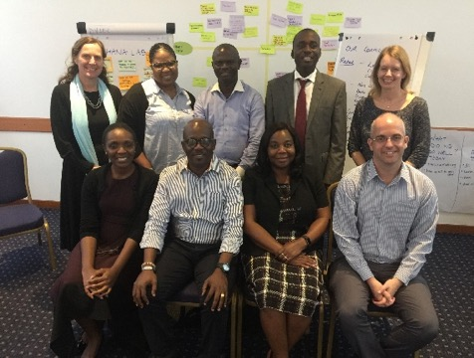
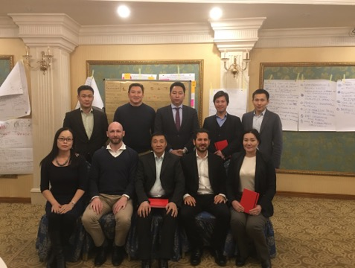
Albania Lab
Kenya Lab
Ghana Lab
Mongolia Lab

Slide 15
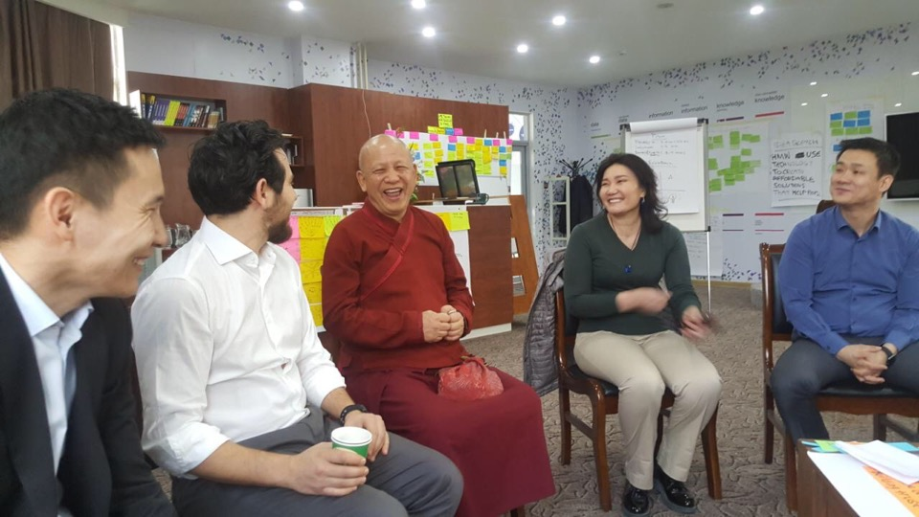

Slide 16
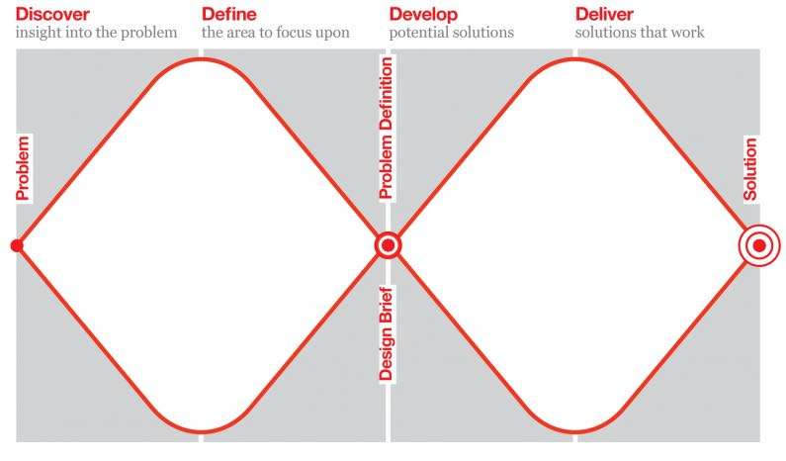
Credit: Design Council

Slide 17
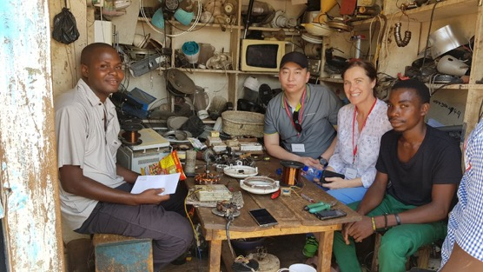
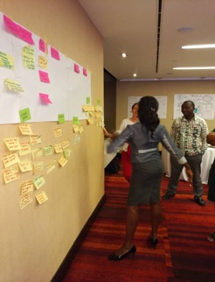
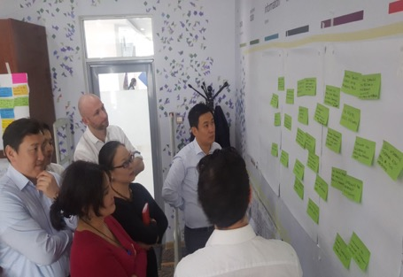
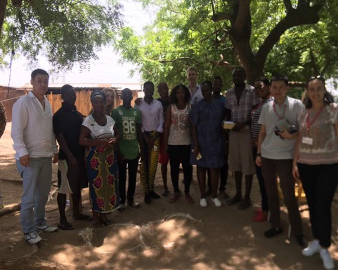

Slide 18
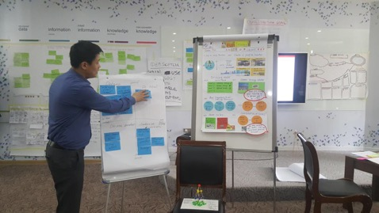
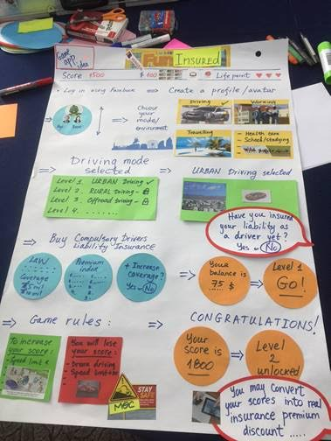
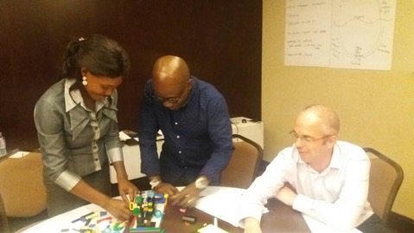

Slide 19
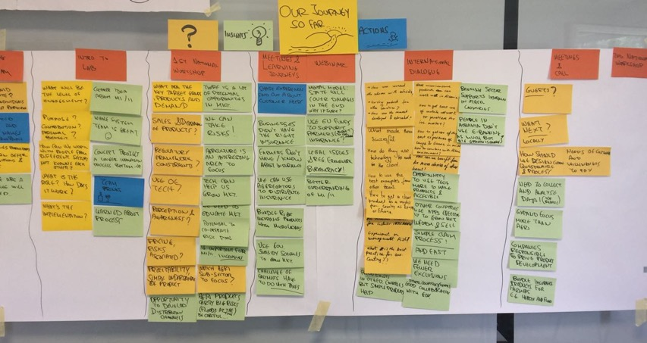
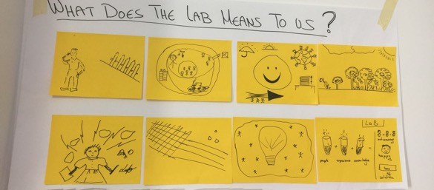

Slide 20
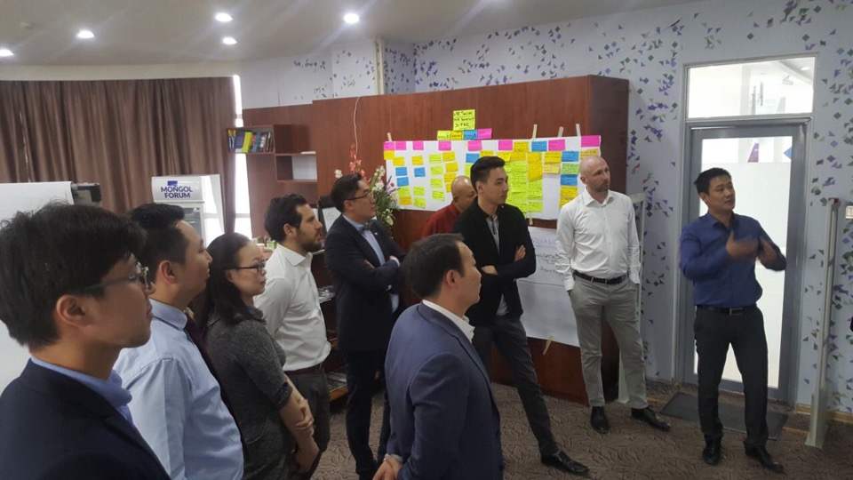

Slide 21
