Slide 1
Access to Insurance Initiative
A global programme for sound regulatory and supervisory frameworks
IAIS-A2ii Consultation Call: November 24, 2016
Privacy Challenges in Mobile Insurance
Stefanie Zinsmeyer
Dr. Nicola Jentzsch

Slide 2
Privacy Challenges in Mobile Insurance
Introduction to Mobile Insurance
Data Protection Challenges in Mobile Insurance
Considerations for Supervision
Conclusion

Slide 3
1. Introduction to Mobile Insurance
“A microinsurance product that relies on mobile phone system and infrastructure to support functions of the insurance process.”
Traditional Insurance Model
Client
Agent or broker
Insurance company
Mobile Insurance Model
Mobile Network Op.
Client
TSP
Insurance company

Slide 4
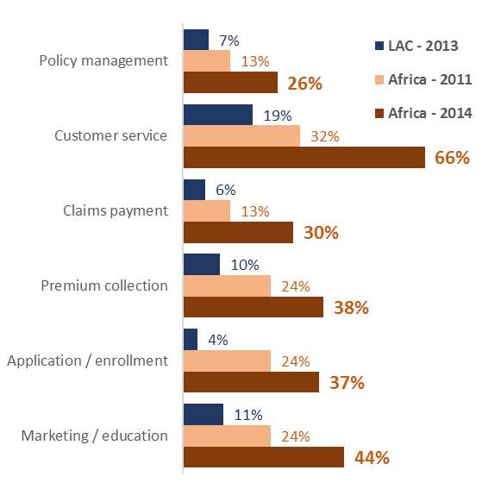
1. Introduction to Mobile Insurance
All steps of the insurance value chain can be paperless
Source: The Landscape of Microinsurance Africa 2015; Microinsurance Network, Munichre Foundation, Microinsurance Centre (2016)
4

Slide 5
1. Introduction to Mobile Insurance
Asia mid-2016: 40 million lives covered*
31 million active policies
+ 9%
*through MicroEnsure and BIMA only
33 emerging markets
Sub-Saharan Africa (58%)
South Asia (19%)
East Asia & Pacific (18%).
2/3 of new 2015 services offer non-life products
Year
Growing mobile insurance coverage and product diversification driven by MNOs
Source: 2015 Mobile Insurance, Savings & Credit Report. GSMA, 2015.

Slide 6
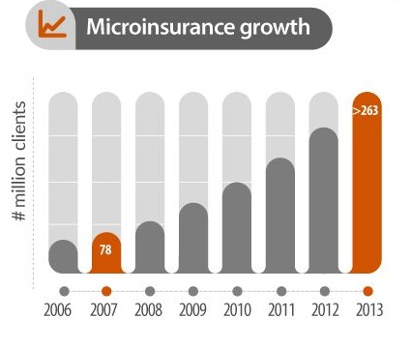
1. Introduction to Mobile Insurance
“It takes one year to insure 1m lives via MNOs vs. 40 years for a typical insurance market”
Source: Inclusivity Solutions

Slide 7
1. Introduction to Mobile Insurance
Potential of Microinsurance
Great potential of micro-insurance (lowering transaction costs)
Provisioning of services over mobile phones (e.g. life, non-life insurance)
Goes hand in hand with Big Data analysis & Big Data business models
Environment of increased interconnection and information sharing
creates new challenges in terms of privacy and data protection

Slide 8
1. Introduction to Mobile Insurance
High & Rising level of Concern regarding Privacy
55% of consumers worldwide decided against buying something online, because of privacy concerns (KPMG Survey in 2016)
Over 66% of consumers are not comfortable with Apps using their personal information (KPMG Survey in 2016)
Somewhat/much more concerned than 1 year ago (CIGI/IPSOS 2016)
LatAm 64%
APAC 59%
MiddleEast/Africa 60%
Notes:
Survey of 6.900 consumers in 2016 in 24 countries (KPMG Report “Crossing the line: Staying on the right side of consumer privacy”)
CIGI/IPSOS survey of more than 24.000 Internet Users 16-64 across 24 countries – how concerned are you about your online privacy compared to one year ago.

Slide 9
1. Introduction to Mobile Insurance
Customer Relationship Management
Customer acquisition & distribution
Propensity to take up offer
Propensity to pay or WTP
Product design
Tailoring of product
Customer management
Model the risks
Advanced fraud estimation (profiling, prediction)
Result: Acquisition costs fall
Conduct risk-based pricing
Preferences mapped in SN
Affordability

Slide 10
2. Data Protection Challenges
in Mobile Insurance
Traditional Insurance Model
Client
Agent or broker
Insurance company
Mobile Insurance Model
Owns mobile incl. meta data
Usage for profiling
Mobile Network Operator
TSP
Insurance company
Client
Client data

Slide 11
2. Data Protection Challenges
in Mobile Insurance
Specific Challenges 1: Fundamental Shifts
Increase of information asymmetries
… between customers and firms
… between firms and supervisors
Personalized prices
Personalized products
Pricing in of customers
Consumer welfare decreases if WTP
Consumer welfare increases
Market Saturation
Market Expansion

Slide 12
2. Data Protection Challenges
in Mobile Insurance
Specific Challenges 1: Fundamental Shifts
Change in competitive strategies of firms
Micro-targeting & pre-selected sign-up
Product tailoring & tailored pricing
Consumer protection: Non-transparency of data processing, consent and calculus of trade-offs,
basic consumer rights (knowledge, action of
redress)

Slide 13
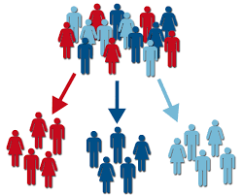
2. Data Protection Challenges
in Mobile Insurance
Specific Challenges 2: Privacy
Traditional insurance
Customer segmentation (demographics, behavior)
Mobile insurance
Hundreds of variables
Personalized targeting
Pre-selected sign-up

Slide 14
3. Considerations for Supervisors
Considerations for Supervisors: Regulatory Framework
Data Protection Law
Data protection provisions regarding collection, processing, analysis and transfer of personal data, tasks for data controllers and right of data subjects (individuals)
Telecommunication law
Confidentiality clauses on keeping the customer‘s data and business matters private
Insurance law
Confidentiality clauses on keeping the customer‘s data and business matters private
Credit reporting law
Data protection provisions as well as conditions of transfer of insurance client data to credit reporting agency
Notes:
Ich werde hier erklären, wie dies traditionellerweise reguliert wird und welche Probleme es gibt mit den neuen TSP Strukturen oder wenn eine MNO mobile insurance anbietet.

Slide 15
3. Considerations for Supervisors
Considerations for Supervisors: Other Aspects
Clear legal framework (status & registration of TSPs)
Legal compliance: Clarification with TSP
Registration of companies
Product review before mass roll-out
Harmonized approach & intense coordination of supervisors
Preservation of most fundamental customer rights

Slide 16
4. Conclusions
Conclusions
Mobile insurance is a very important development with potentially great benefits
Benefits must be balanced with challenges
Supervision and regulation
Customer protection

Slide 17
Thank you!
For more information please visit www.a2ii.com or send us an email at consultation.call@a2ii.org

Slide 18
Access to Insurance Initiative
A global programme for sound regulatory and supervisory frameworks
IAIS-A2ii Consultation Call: 24 November 2016
South Africa: Risks and challenges in mobile insurance
Eugene du Toit
FSB, South Africa

Slide 19
MNO insurance partner structures and main risks
Mobile Network Operators (MNO): Different structures of operating in the insurance industry:
Main risks identified in the South African mobile insurance market:
Registered insurer part of the MNO Group
Cell captive arrangements
Brand arrangements
Data protection and data privacy
Abusive marketing practices
Operational risk, specifically outsourcing and partnership risk
Increased interconnectedness; Information symmetry; Unauthorised use of data
Negative option marketing; Lack of identification of insurer;
Lack of information relating to pivotal contract terms
Lack of oversight and data;
Insurer at risk and results in inappropriate consumer protection throughout the life cycle of the product
Prevalent in cell captive and binder agreement structures

Slide 20
Regulatory framework
The Constitution of South Africa
Laws of general application
Financial Services Laws
Protection of Personal Information Act (POPI)
Consumer Protection Act
Long-term Insurance Act
Short-term Insurance Act
Insurance Bill
Policyholder Protection Rules
Regulations

Slide 21
Risk mitigating actions
1. Proposed amendments to legislation
Policyholder Protection Rules
Regulations
General principles regarding fair treatment of policyholders
Product design and monitoring
Disclosure
Advertising
Negative option marketing
Negative option selection of policy terms
Complaints management
Complaints management
Consent to insure a life
Data management
Outsourcing
2. Targeted supervisory approach
Targeting of mobile insurance through a focussed / theme based supervisory approach

