Slide 1
12th Consultative Forum
Panel 2 Supervisory Apporaches on Insurtech and Regulatory Challenges
IAIS Report: FinTech Developments in the Insurance Industry
Peter van den Broeke
With special thanks to Denise Garcia
Research and Development General Director, CNSF
Colombo, Sri Lanka
20 March 2018

Slide 2
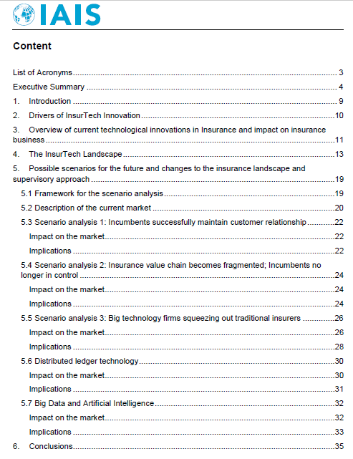
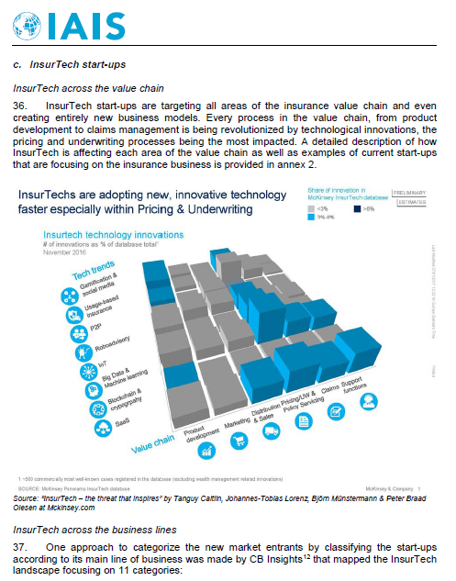
Background
Overview of FinTech developments relevant to the insurance industry - description, drivers, investment landscape.
Analysis of potential impacts to the insurance landscape and to supervisory approach, based on three scenarios.
Objectives
FinTech
Task Force
Brazil, France, Mexico, US, UK, IAIS Secrt.
Roundtable Meetings
Research
last
Feb-Mar 2017
ExCo Approval
Publication
www.iaisweb.org

Slide 3
Overview: innovations in the value chain
Product
Development
Price and
Underwriting
Distribution and Marketing
Claims
Management
Meeting changing customer needs with new offerings.
Collecting and analyzing big data
Developing new approaches to underwrite risk & predict loss
Enhancing and improving customer interactions.
Improving claims administration, reducing operational costs and increasing efficiency.
Usage based
Behavioural based
On demand
P2P
Connected devices (IoT)
Drones
Predictive Analytics
Cloud computing
Mobile & online distribution, aggregators, comparison sites.
Drones
DLT/Blockchain
Artificial Intelligence

Slide 4
Scenario Analysis
Incumbents successfully maintain the customer relationship
Fragmentation of insurance value chain; incumbents no longer in control
Big technology firms squeezing out traditional insurers

Slide 5
Scenario Analysis
Competitiveness
Consumer choice
Interconnectedness
Regulatory oversight
Incumbents successfully maintain the customer relationship
Fragmentation of insurance value chain; incumbents no longer in control
Big technology firms squeezing out traditional insurers
BM Viability & Cap. Req.
Conduct of business
Data ownership

Slide 6
Analysis & supervisory considerations (SC)
Competitiveness
Expected to reduce in long term.
SC: how to do more to encourage or accommodate competition and new entrants?
Consumer choice
SC: how to ensure that the ability to compare products between providers is not compromised as segmentation of customers increases?
Expected to reduce -extent varies by scenario.

Slide 7
Analysis & supervisory considerations (SC)
Interconnectedness
SC: how to include in current regulatory reports additional information in order to monitor potential risks of interconnectedness?
Expected to increase.
Ability of regulatory oversight
SC: how to reassess the regulatory framework in order to ensure consumers’ adequate protection and to continue to monitor market trends?
Expected to reduce.

Slide 8
Analysis & supervisory considerations (SC)
Business model viability & Cap. Req.
SC: how to adjust the regulatory capital framework to include new business models and changes in risk profile changes of insurers?
Resilience of current business model expected to reduce.
Conduct of business
SC: how to require a minimum level of transparency for consumers that highlight the potential conflicts of interest?
Potential increase in risk of reflecting firm’s objectives rather than consumer’s.

Slide 9
Analysis & supervisory considerations (SC)
Data ownership
Potential increase in risk of unauthorized access, use or transfer of personal data.
SC: how to strengthen regulatory provisions regarding data access, use and transferability between providers, as well as provisions related to IT management, cyber security and internal controls for outsourcing technical services?

Slide 10
Other legal & regulatory considerations
The regulatory status of P2P insurance providers, which may have the characteristics of insurance firms, agent/brokers or reinsurers;
The legal certainty and enforceability of smart contracts;
Jurisdictional aspects of Autonomous Decentralised Organisations (DOAs) that - for example using smart contracts on blockchains – may (seem to) exist as virtual insurers.

Slide 11
Conclusions
FinTech developments are potentially disruptive.
Currently uncertain to oversee and understand how the insurance market and its supervision will be affected.
Scenario analysis and possible implications for supervision can assist in shaping the future strategic direction of supervisors and IAIS.
Report presents relevant challenges that insurance supervisors may face in the near future when addressing FinTech innovations.

Slide 12
Thanks
12th Consultative Forum
Panel 2 Supervisory Apporaches on Insurtech and Regulatory Challenges
Peter.vandenbroeke@bis.org

